Slide 1
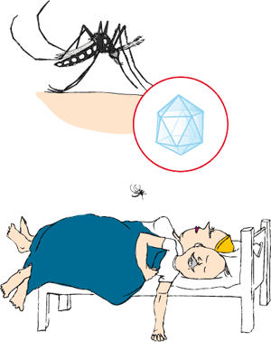

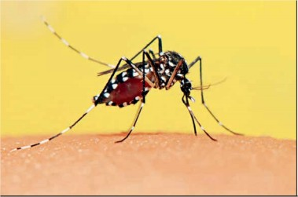
Togaviruses and Flaviviruses
Dr. CHHAY Sokdalis

Slide 2
Objectives
List the different genus of arbovirus.
Illustrate the structure and replication of Alphaviruses and Flavivirus.
Explain why Alphaviruses and Flavivirus need arthropod for infection.
Describe the pathogenesis of Alphaviruses and Flavivirus infection.
Describe the immune against Alphaviruses and Flavivirus
Explain how Alphaviruses and Flavivirus transmitted.
Describe the clinical manifestations of Alphaviruses and Flavivirus.
List the techniques for detecting Alphaviruses and Flavivirus.
Describe the treatment of Alphaviruses and Flavivirus.

Slide 3
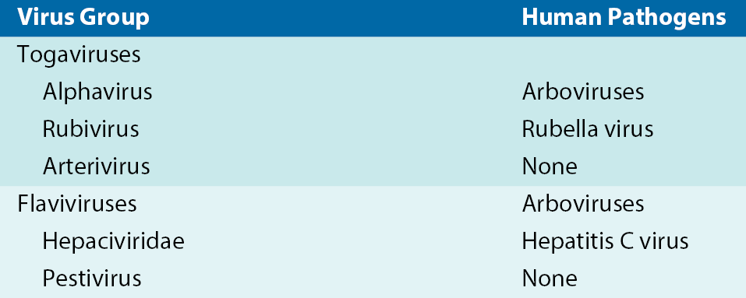
Togaviruses and Flaviviruses

Slide 4
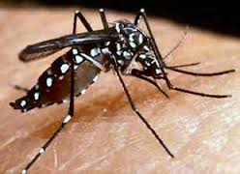
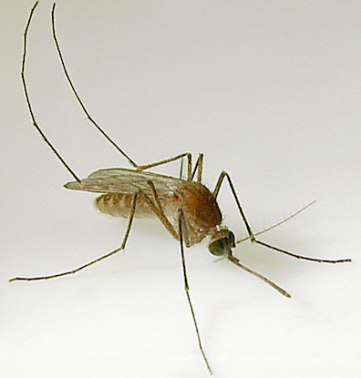
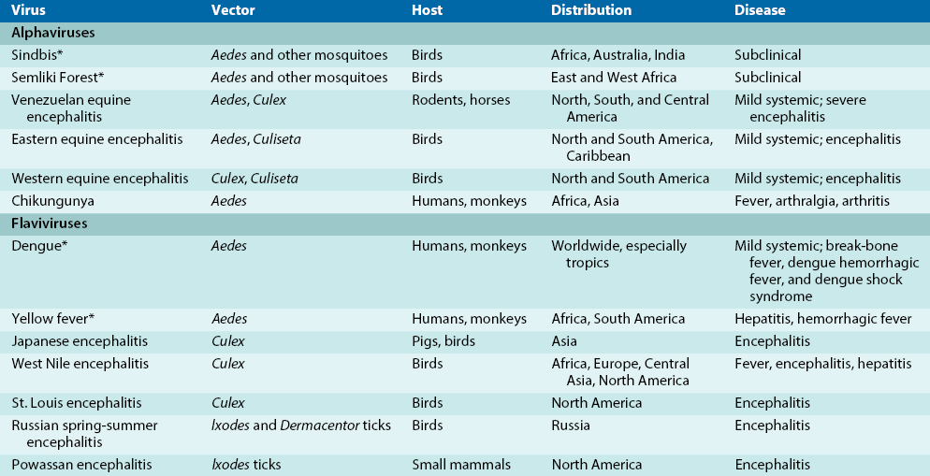
Arboviruses

Slide 5
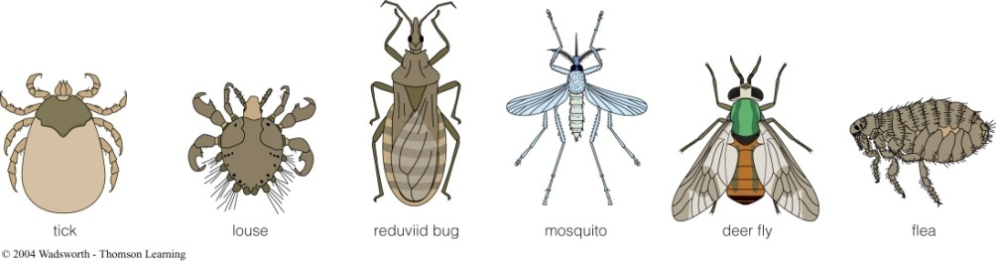
ALPHAVIRUSES AND FLAVIVIRUSES
Arboviruses: spread by arthropod vectors.
Broad host range: vertebrates (mammals, birds, amphibians, reptiles) and invertebrates (mosquitoes, ticks).
Zoonoses: diseases spread by animals or with an animal reservoir .

Slide 6
Structure and Replication of Alphaviruses
Icosahedral capsid, envelope and (+) ss RNA genome.
Slightly > picornaviruses (45-75 nm in diameter)
3 structural proteins:
Capsid (C) protein encloses viral RNA→nucleocapsid,
2 proteins (E1 and E2): glycoproteins →hemagglutinin containing viral spikes.
Genome: encodes early and late proteins.

Slide 7
Structure and Replication of Alphaviruses
Attach: specific receptors (vertebrates: humans, monkeys, horses, birds, reptiles, and amphibians, and invertebrates: mosquitoes and ticks).
Penetration: receptor mediated endocytosis.
Translation: genomes bind to ribosomes as mRNA→early and late phases.
Early protein: 2/3 RNA →a polyprotein→ cleaved 4 nonstructural (NSPs 1- 4): RNA-dependent RNA polymerase.
26S late mRNA: 1/3 genome transcribed from template: encodes capsid (C) and envelope (E1-E3) proteins.

Slide 8
Structure and Replication of Alphaviruses
Late in replication cycle, viral mRNA can account for as much as 90% of mRNA in infected cell.
Abundance of late mRNAs allows production of a large amount of structural proteins→ packaging virus.
Alphavirus glycoproteins→plasma membrane.
Alphaviruses: released on budding from plasma membrane.

Slide 9
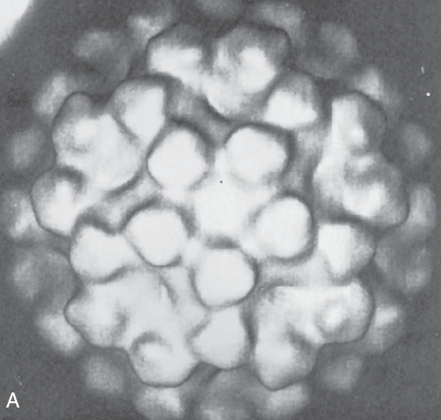
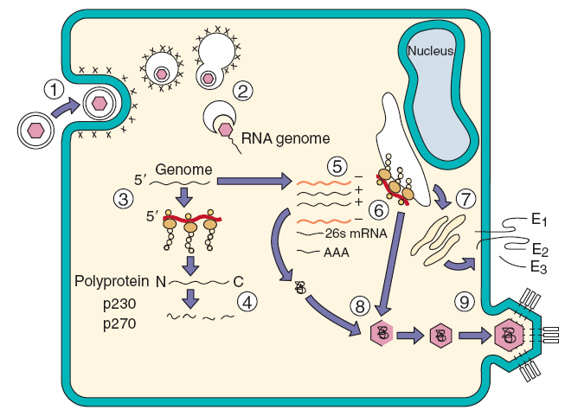
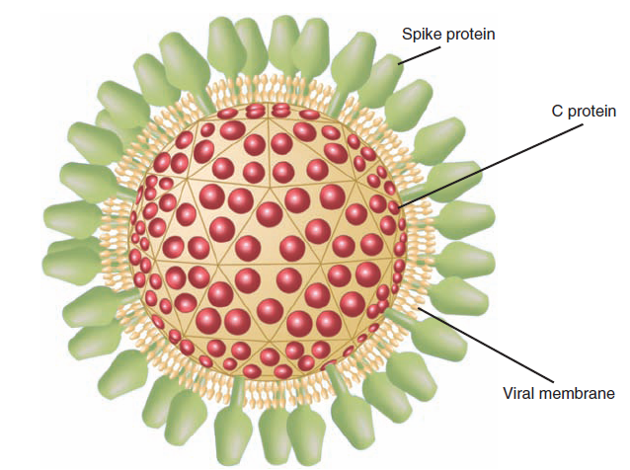
Structure and Replication of Alphaviruses

Slide 10
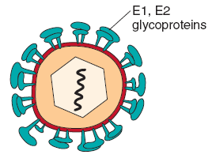
Structure and Replication of Flaviviruses
Genome: (+) ssRNA,
Capsid: icosahedral
Envelope slightly < alphavirus: 40-65 nm diameter.
E viral glycoprotein folds over, pairs up with another E glycoprotein, and lies flat across surface of virion→outer protein layer.
Attachment and penetration: same as alphaviruses.
Enter macrophages, monocytes, and other cells that have Fc receptors, when virus is coated with Ab.
Ab actually enhances infectivity of these viruses by providing new receptors for virus and promoting viral uptake into these target cells.

Slide 11
Structure and Replication of Flaviviruses
Entire genome→translated→single polyprotein.
Yellow fever: Polyprotein→ 5 nonstructural proteins (protease and RNA dependent RNA polymerase) + capsid and envelope structural proteins.
Envelope: bud into endoplasmic reticulum→ released by exocytosis or cell lysis mechanisms.
Lytic response in vertebrate hosts.
Persistent infection in invertebrate hosts.

Slide 12
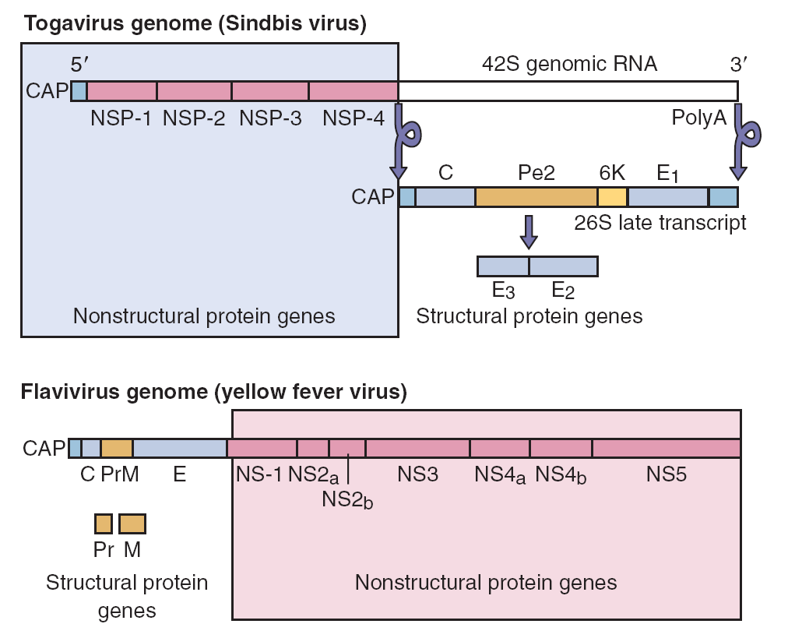
Structure and Replication of Flaviviruses

Slide 13
Pathogenesis and Immunity
Arboviruses: bite of an arthropod (mosquito)→course of infection (vertebrate host and invertebrate vector).
Cause lytic or persistent infections.
Blocks cellular mRNA from binding to ribosomes.
Increased permeability of target cell membrane and changes in ion concentrations→alter enzyme activities→translation viral mRNA over cellular mRNA.
Displacement of cellular mRNA from protein synthesis machinery prevents rebuilding and maintenance of cell→major cause death virus-infected cell.
Alphaviruses (WEEV): nucleotide triphosphatase→ degrades deoxyribonucleotides→depleting DNA production.

Slide 14
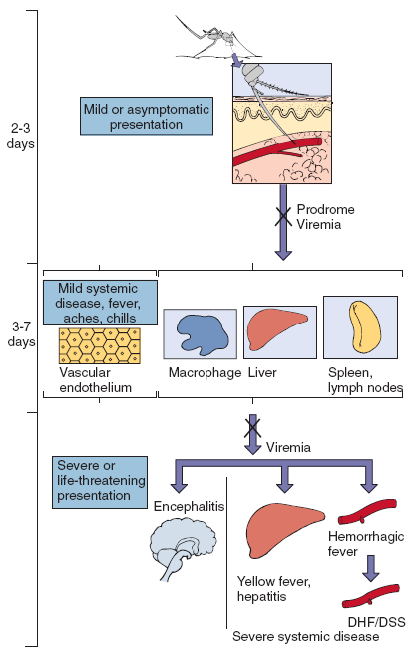
Pathogenesis and Immunity
Female mosquitoes→viruses→ blood meal→viremic vertebrate host.
Virus→infects epithelial cells midgut mosquito→spreads → circulation→infects salivary glands.
Virus→persistent infection and replicates to high titers in cells.
Salivary glands→release virus→ saliva.
Not all arthropod species support this type of infection.

Slide 15
Pathogenesis and Immunity
Disease Mechanisms of Togaviruses and Flaviviruses
cytolytic, except for rubella and hepatitis C.
viremia and systemic infection.
good inducers of interferon→flulike symptoms during prodrome.
infect cells of monocyte-macrophage lineage. Nonneutralizing antibody can enhance flavivirus infection via Fc receptors on cells.
Immunity is believed to be permanent after a single infection.
Both humoral antibody and cellular immune responses →protection and recovery from infection.
Build up immunity → inapparent infections;
Antibodies to local arthropod-borne virus increases with age.

Slide 16
Epidemiology
Disease/Viral Factors
Inactivated: drying, soap, and detergents.
Infect mammals, birds, reptiles, and insects.
Asymptomatic or nonspecific (flulike fever or chills), encephalitis, hemorrhagic fever, or arthritis
Transmission
Specific arthropods (zoonosis: arbovirus)
Who Is at Risk?
People who enter ecologic niche of arthropods infected by arboviruses.

Slide 17
Epidemiology
Geography/Season
Endemic regions for each arbovirus are determined by habitat of mosquito or other vector.
Aedes mosquito, which carries dengue and yellow fever, is found in urban areas and in pools of water.
Culex mosquito, which carries St. Louis encephalitis and West Nile encephalitis viruses, is found in forest and urban areas.
Disease is more common in summer.
Modes of Control
Mosquito breeding sites and mosquitoes should be eliminated.
Live attenuated yellow fever virus and inactivated Japanese encephalitis virus vaccines.

Slide 18
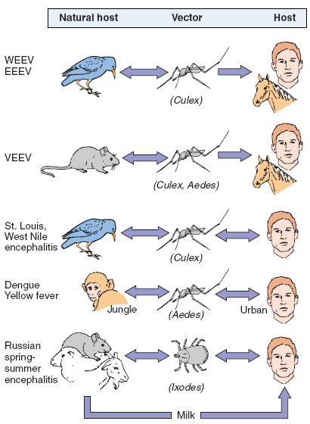
Epidemiology

Slide 19
Clinical Syndromes
Incidence of arbovirus disease is sporadic.
Alphavirus: usually asymptomatic or cause low grade disease, such as flulike symptoms (chills, fever, rash, and aches) that correlate with systemic infection during initial viremia.
EEEV, WEEV, and Venezuelan equine encephalitis virus (VEEV) →encephalitis in humans.
Equine encephalitis viruses are usually more of a problem to livestock than to humans.
An affected human: fever, headache, and decreased consciousness 3-10 days after infection.
Chikungunya: crippling arthritis associated with serious disease caused by infection with these viruses.

Slide 20
Clinical Syndromes
Most flavivirus infections are relatively benign, but serious aseptic meningitis and encephalitic or hemorrhagic disease can occur.
Encephalitis viruses: St. Louis, West Nile, Japanese, Murray Valley, and Russian spring-summer viruses.
Symptoms and outcomes: similar togavirus encephalitis.
Approximately 20% WNV→West Nile fever (fever, headache, tiredness, and body aches, occasionally with a skin rash on trunk of body and swollen lymph glands) usually lasting only a few days.
Encephalitis, meningitis, or meningoencephalitis occurs in approximately 1% of WNV-infected individuals, with risk increasing with age.

Slide 21
Clinical Syndromes
Hemorrhagic viruses: dengue and yellow fever viruses.
Yellow fever infections: severe systemic disease, with degeneration of liver, kidney, and heart, as well as hemorrhage.
Liver→jaundice but massive gastrointestinal hemorrhages “black vomit”.
Dengue: major worldwide problem, 100 million cases/year (Central and northern South America).
Break-bone fever symptoms and signs: high fever, headache, rash, and back and bone pain 6-7 days.
DHF and dengue shock syndrome (DSS) (Nonneutralizing Ab →uptake virus→macrophages→memory T cells→activated→ cytokines→inflammatory reactions→ weakening and rupture of vasculature, internal bleeding, and loss of plasma→shock symptoms and internal bleeding.

Slide 22
Clinical Syndromes
Dengue 3 clinical stages:
Dengue fever:
Abrupt onset of high fever (biphasic fever: break bone fever or saddle back fever)
Maculopapular rashes (chest and upper limb)
Severe frontal headache
Muscle and joint pains
Lymphadnopathy
Retro-orbital pain
Loss of appetite, nausea and vomiting

Slide 23
Clinical Syndromes
Dengue hemorrhagic fever (DHF):
High grade continuous fever
Hepatomegaly
Thrombocytopenia (platelet <1Lakh/mm³)
Raised hematocrit
Hemorrhage (bleeding skin, nose, mouth and gum).
Dengue shock syndrome (DSS): DHF+Shock:
Rapid and weak pulse
Narrow pulse pressure or hypotension
Presence of cold clammy skin
Restlessness.

Slide 24
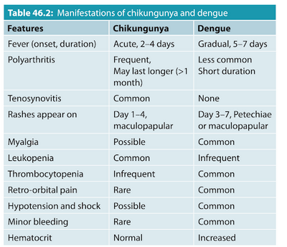
Clinical Syndromes

Slide 25
Laboratory Diagnosis
Culture: grown in both vertebrate and mosquito cell lines, but most are difficult to isolate.
Detection: cytopathologic studies, immunofluorescence, and hemadsorption of avian erythrocytes.
Detection and characterization can be performed by RT-PCR testing of genomic RNA or viral mRNA in blood or other samples.
Monoclonal antibodies→distinguishing individual species and strains of viruses.
Serologic methods: hemagglutination inhibition, ELISA, and latex agglutination.

Slide 26
Treatment, Prevention, and Control
No treatments→supportive care.
Preventing spread: elimination of its vector and breeding grounds (control of mosquito population and monitor bird).
A live vaccine against yellow fever virus and killed vaccines against EEEV, WEEV, Japanese encephalitis virus, and Russian spring-summer encephalitis virus.
Yellow fever vaccine: administered intradermally and elicits lifelong immunity to yellow fever and possibly other cross-reacting flaviviruses.

Slide 27
Reference
Patrick R. Murray, Ken S. Rosenthal, Michael A. Pfaller. MEDICAL MICROBIOLOGY. 2013. 7th EDITION.
Cynthia Nau Cornelissen, Bruce D. Fisher, Richard A. Harvey, Lippincott’s Illustrated Reviews: Microbiology. Third Edition. 2013.
Kenneth J. Ryan, MD, C. George Ray. Sherris Medical Microbiology. 6th edition. 2014.

